Slide 1

Student Task Manager Hayden Duong

Slide 2
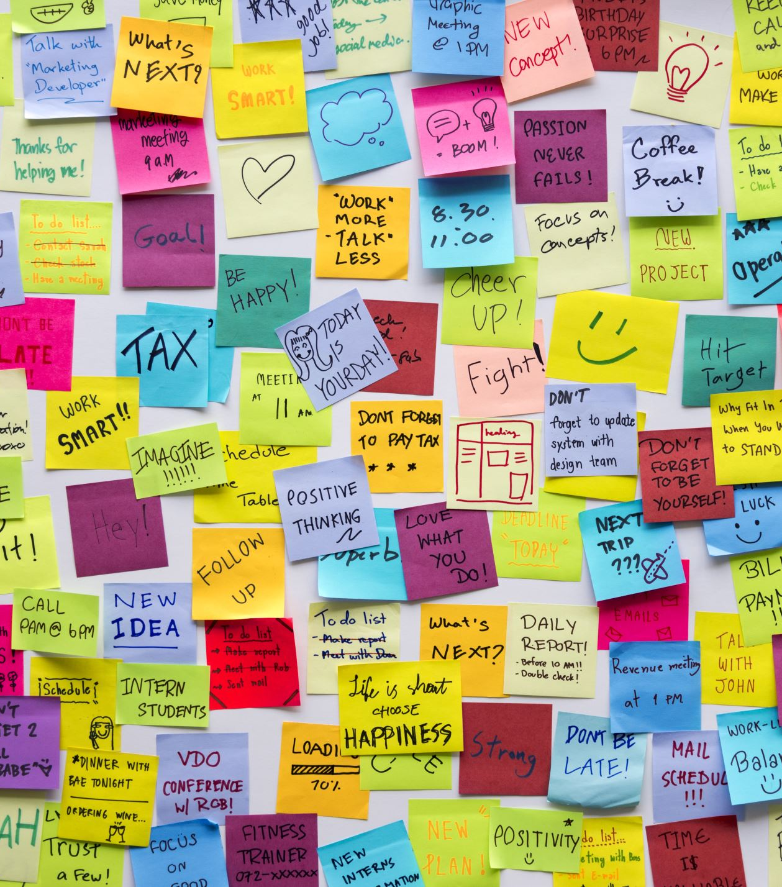
A Web Application
Aim: help students effectively organize tasks, manage deadlines, and track their progress
Key functionalities:
Task Management: Create, read, update, and delete tasks (CRUD).
Task Details: Ability to add description, set due dates, and status.
User Accounts: Secure login for individual task list with Oauth authentication.

Slide 3
Core Technologies
Frontend: Javascript
Backend: Node.js
Database: Cloud Firestore
Containerization: Docker
Orchestration: Google Kubernetes Engine
Monitoring: Google Monitoring – Metrics, Logs Explorer

